Slide 1
Competitions - CTFs
Marcin Kyć, Tomasz Dąbrowski

Slide 2
Nodes
Category – name, description,
Challenge – name, description, points, flag, ctfName,
Team – name,
Member – name, email.

Slide 3
Relationships
(challenge) IS_IN_CATEGORY (category),
(member) SOLVED (challenge) – time: datetime(...),
(member) IS_MEMBER_OF (team) – since: date(...)

Slide 4
Generator

Slide 5
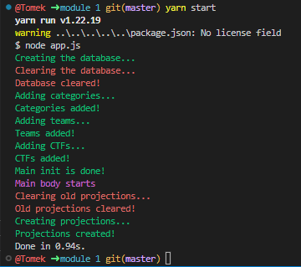
Initial generation

Slide 6
Competency questions
And their queries

Slide 7
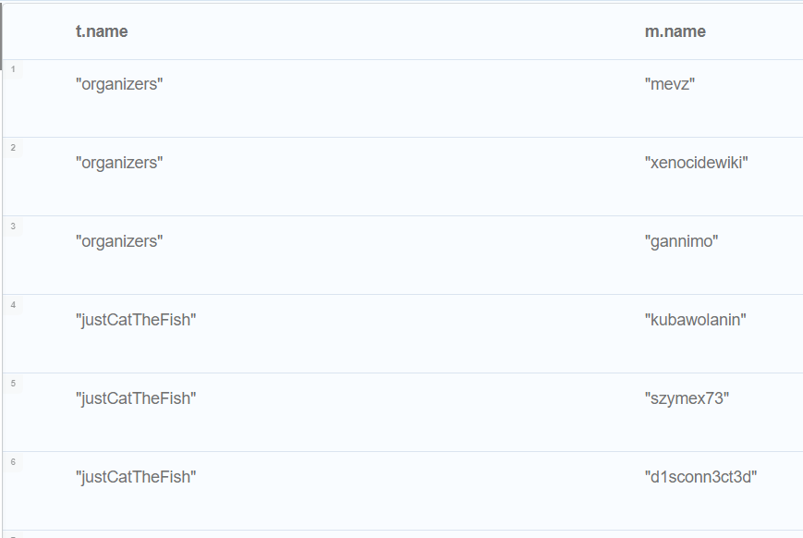
1. Teams and their members
match (m:Member) - [:IS_MEMBER_OF] -> (t:Team) return t.name, m.name

Slide 8
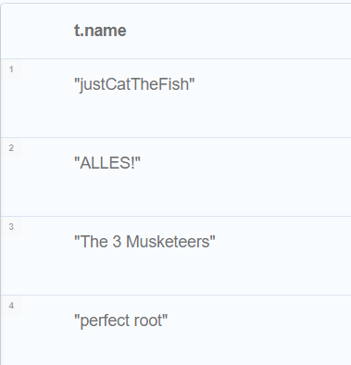
2. Teams that solved at least 6 tasks
match (:Challenge) <- [r:SOLVED] - (:Member) - [:IS_MEMBER_OF] -> (t:Team) with count(r) as cr, t where cr >= 6 return t.name

Slide 9
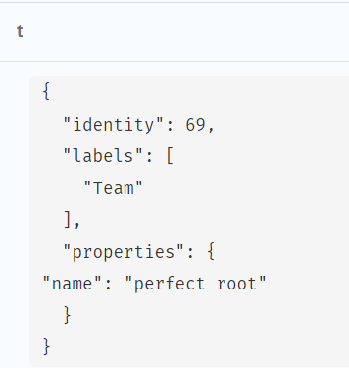
3. Teams that managed to solve at least one task in each category
match (t:Team) <-- (:Member) --> (:Challenge) --> (c:Category) call {match (c:Category) return count(c) as count_cat} with count(distinct c) as cc, t, count_cat where cc = count_cat return t, cc

Slide 10
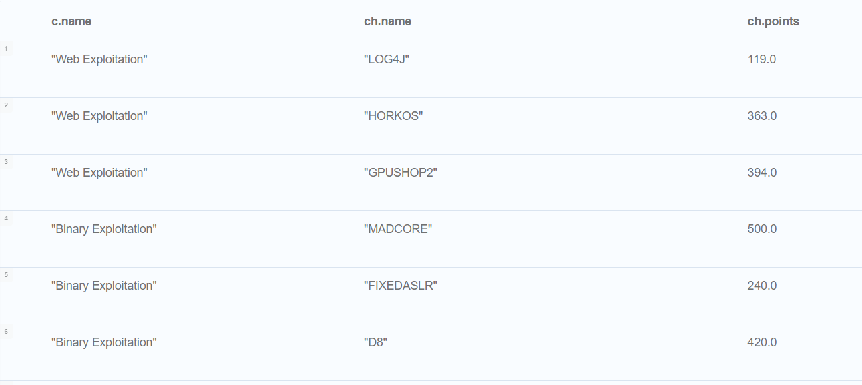
4. Categories and their challenges
match (c:Category) <- [:IS_IN_CATEGORY] - (ch:Challenge) return c.name, ch.name, ch.points

Slide 11
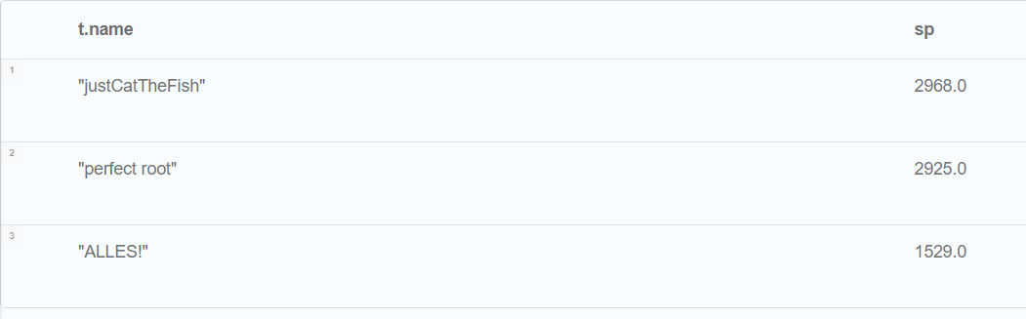
5. 3 teams and their members with the highest scores
match (t:Team) <- [:IS_MEMBER_OF] - (:Member) - [:SOLVED] -> (c:Challenge) with sum(c.points) as sp, t return t.name, sp order by sp desc limit 3

Slide 12
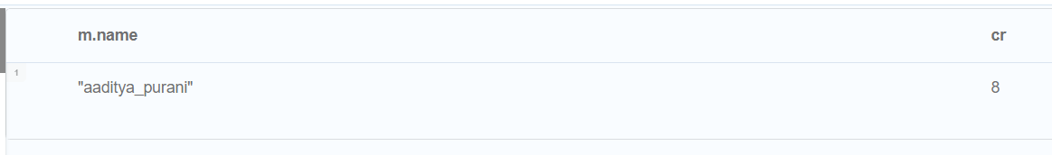
6. Member/s who solved the highest number of challenges
match (m:Member) - [r:SOLVED] -> (:Challenge) call {match (m:Member) - [r:SOLVED] -> (:Challenge) with count(r) as cr, m with max(cr) as mr return mr} with count(r) as cr, m, mr where cr = mr return m.name, cr

Slide 13
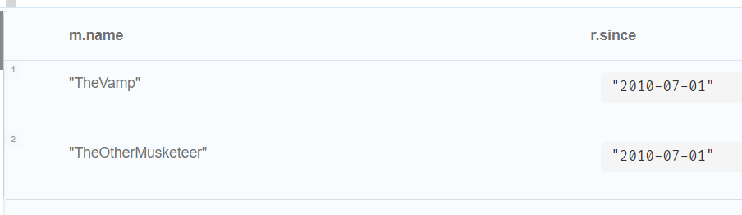
7. The person/s who joined a team the longest time ago
match (m:Member) - [r:IS_MEMBER_OF] -> () call {match (m:Member) - [r:IS_MEMBER_OF] -> () with min(r.since) as ms return ms} with ms, r, m where ms = r.since return m.name, r.since

Slide 14
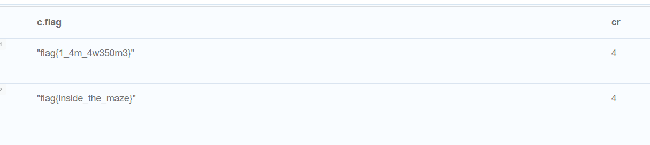
8. The flag/s of a challenge/s that was solved by the biggest number of members
match (:Member) - [r:SOLVED] -> (c:Challenge) call {match (:Member) - [r:SOLVED] -> (c:Challenge) with count(r) as cr, c with max(cr) as mr return mr} with count(r) as cr, c, mr where cr = mr return c.flag, cr

Slide 15
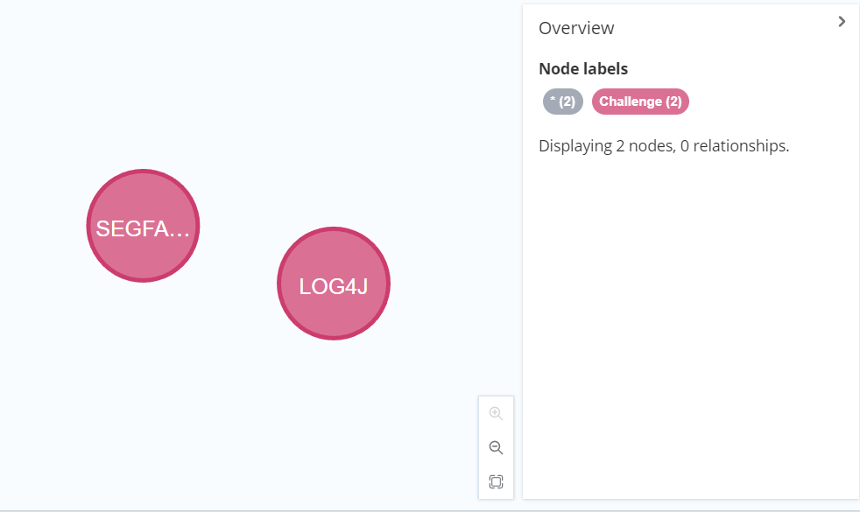
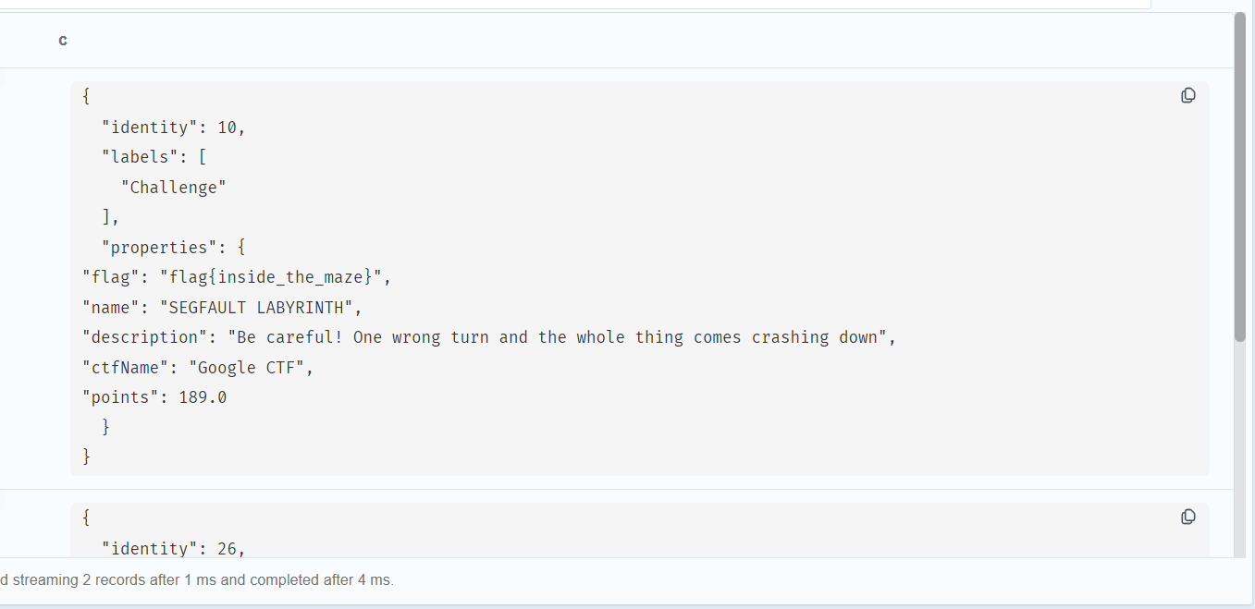
9. The challenges that were solved by the biggest number of teams and their flags
match (t:Team) <- [:IS_MEMBER_OF] - (:Member) - [r:SOLVED] -> (c:Challenge) call {match (t:Team) <- [:IS_MEMBER_OF] - (:Member) - [r:SOLVED] -> (c:Challenge) with count(r) as cr, c with max(cr) as mc return mc} with count(r) as cr, c, mc where cr = mc return c.flag, cr

Slide 16
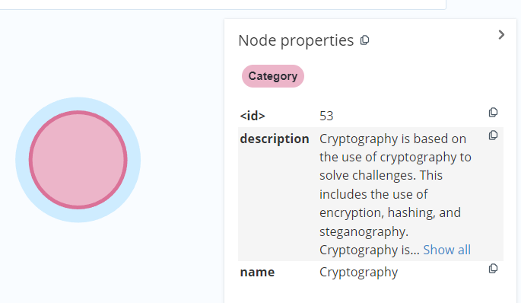
10. Category that has the biggest sum of possible points from challenges
match (c:Category) <- [:IS_IN_CATEGORY] - (ch:Challenge) call {match (c:Category) <- [:IS_IN_CATEGORY] - (ch:Challenge) with sum(ch.points) as sum_pts, c return max(sum_pts) as max_points} with sum(ch.points) as sum_points, c, max_points where sum_points = max_points return c, sum_points

Slide 17
Projections
Graph analysis

Slide 18
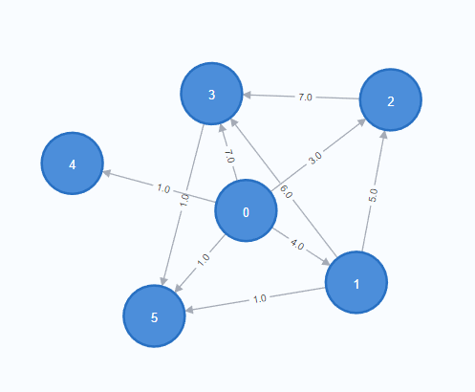
1. Weights between teams that shows how many same tasks teams solved
CALL gds.graph.project.cypher(
'proj1',
'MATCH (t:Team) RETURN id(t) AS id, labels(t) AS labels',
'MATCH
(t1:Team)<--(:Member)-[:SOLVED]->(r:Challenge)<-[:SOLVED]-(:Member)-->(t2:Team)
WHERE ID(t1) < ID(t2)
RETURN DISTINCT id(t1) AS source, id(t2) AS target, count(r)
AS weight'
)

Slide 19
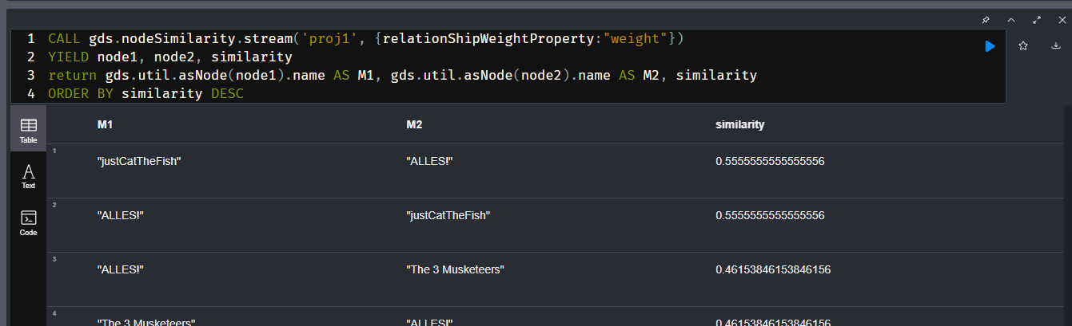
1st algorithm - Node similarity - What is the similarity between each team?
CALL gds.nodeSimilarity.stream('proj1', {relationShipWeightProperty:"weight"})
YIELD node1, node2, similarity
return gds.util.asNode(node1).name AS M1, gd.util.asNode(node2).name AS M2, similarity
ORDER BY similarity DESC

Slide 20
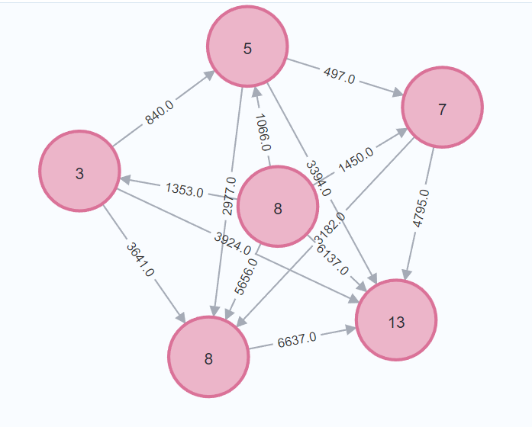
2. Categories in properties have number of solved tasks in each category by teams. Weights represents the sum of points of challenges of two connected categories.
CALL gds.graph.project.cypher(
'proj2',
'MATCH (c:Category)<--(:Challenge)<-[r:SOLVED]-(:Member)-->(t:Team) RETURN
DISTINCT id(c) AS id, count(r) AS numberOfSolved,
labels(c) AS labels',
'MATCH
(c1:Category)<--(ch1:Challenge)<-[r1:SOLVED]-(:Member)-->(t:Team)<--(:Member)-[r2:SOLVED]->(ch2:Challenge)-->(c2:Category)
WHERE ID(c1) < ID(c2)
RETURN DISTINCT id(c1) AS source, id(c2) AS target,
sum(ch1.points + ch2.points)
AS weight')

Slide 21
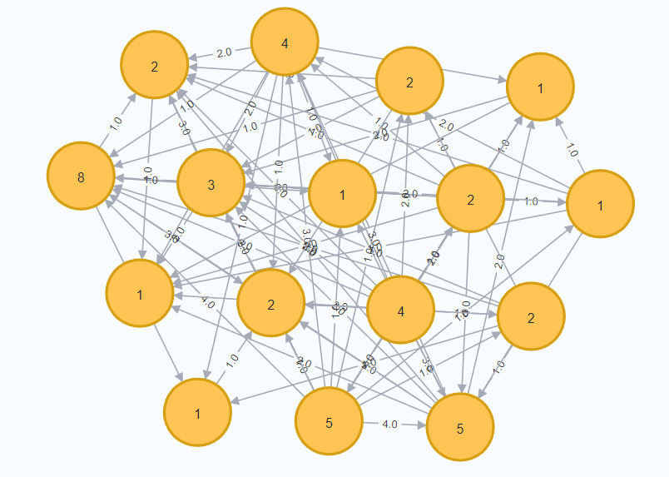
3. Weights - in how many different categories two members have managed to solve at least one challenge. In members properties - how many challenges each managed to solve.
CALL gds.graph.project.cypher(
'proj3',
'MATCH (:Challenge)<-[r:SOLVED]-(m:Member)-->(t:Team) RETURN
DISTINCT id(m) AS id, count(r) AS numberOfSolved,
labels(m) AS labels',
'MATCH
(m1:Member)-[:SOLVED]->(:Challenge)-->(c:Category)<--(:Challenge)<-[:SOLVED]-(m2:Member)
WHERE ID(m1) < ID(m2)
RETURN DISTINCT id(m1) AS source, id(m2) AS target,
count(c) AS weight')

Slide 22
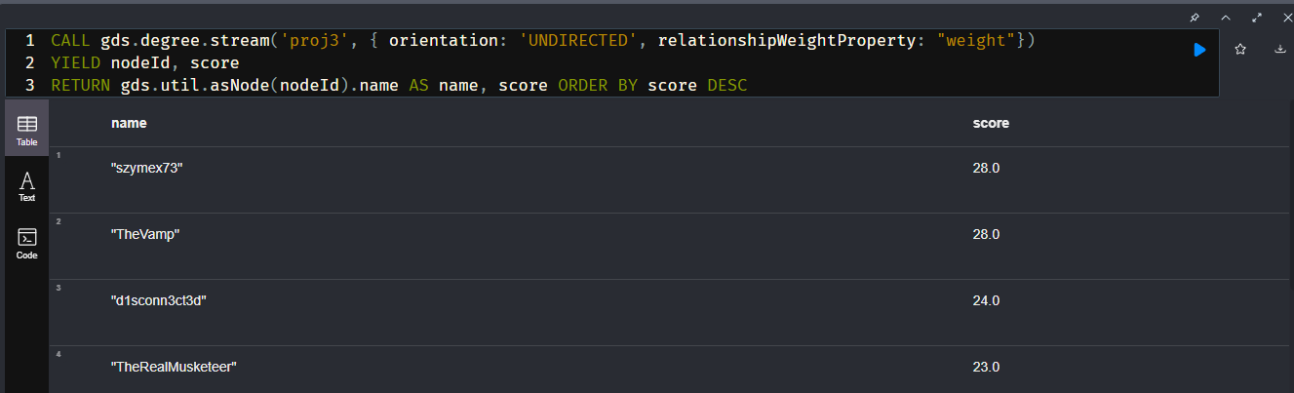
2nd algorithm – degree centrality of players across categories and challenges
CALL gds.degree.stream('proj3', { orientation: 'UNDIRECTED', relationshipWeightProperty: "weight"}) YIELD nodeId, score RETURN gds.util.asNode(nodeId).name AS name, score ORDER BY score DESC

Slide 23
Thank you for your attention

